Slide 1

HOSPITAL DATABASE SYSTEM

Slide 2
INTRODUCTION:
Hospital are the essential part of our lives, providing best medical facilities to people suffering from various ailments, which may be due to change in climatic conditions, increased work-load, emotional trauma stress etc.
It is necessary for the hospitals to keep track of its day-to-day activities & records of its patients, doctors, inpatients, outpatients and other staff personals that keep the hospital running smoothly & successfully. But keeping track of all the activities and their records on paper is very cumbersome and error prone.
We have developed an automated version of the manual system, named as “Hospital Management System..

Slide 3
DOCTOR:
FUNCTIONAL REQUIREMENTS:
DESCRIPTION:
Ideally, medical software should have a section with information about physicians that provide their service at the establishment.
The section should contain a list of the available doctors with their respective unique id’s and expertise of the medical professionals.
EVENTS:
A) ADD DOCTOR:
Its facilities the admin to add a new doctor by filling the form with a unique id and their field of expertise and their name when a new doctor joins in service.
B) DELETE DOCTOR:
Its facilities the admin to delete the doctor who resigns for one or more reason. It can be easily deleted by entering the doctor id in the given text box.

Slide 4
STAFF:
FUNCTIONAL REQUIREMENTS:
DESCRIPTION:
It is also mandatory to keep account of the staffs who are working in the hospitals.
This section should contain the list of the staffs available with their name, unique id and their salary.
The staffs can belong to the category like nurse, cleaner, sweeper, ward boy, receptionist, lab technicians.
EVENTS:
A) ADD STAFF:
Its facilities the admin to add a new staff by filling the form with necessary details like name, unique id and their salary whenever a new staff joins in.
B) DELETE STAFF:
It provides the admin to delete a particular staff when a staff resigns for one or more reason. The admin can delete a staff by simply giving the staff id who is no more working in the hospital.

Slide 5
INPATIENT:
FUNCTIONAL REQUIREMENTS:
DESCRIPTION:
Inpatient case management has the potential to improve both processes and outcomes of hospital care.
This section lists all the inpatient’s details with their relevant information like name, gender, address, patient’s unique id, treating doctor id, room no, date of admit, date of discharge.
EVENTS:
1) ADD INPATIENT:
Inpatient care starts with the admission to the hospital for medical treatment. Whenever a new patient visits as an inpatient the admin must register the patient details by filling the form.

Slide 6
OUTPATIENT:
FUNCTIONAL REQUIREMENTS:
DESCRIPTION:
First and foremost, management software should have hospital registration software to provide the possibility to register outpatients into the hospital’s system and file in all relevant information.
Outpatient care involves any sort of care provided without admission into the hospital. This section list all the outpatient’s details which includes the patient’s unique id, name, date, their treating doctor id.
EVENTS:
1) ADD OUTPATIENT:
Procedure within an outpatient clinic include filling the form with the necessary details like the name, patient’s unique id, date and their treating doctor id which is done by the admin.

Slide 7
ROOMS:
FUNCTIONAL REQUIREMENTS:
DESCRIPTION:
A good hospital management software must list the room details with their availability and non-availability status.
This section lists the room no, room type, status, patient-id.
The patient id will be included only when it is occupied by a patient else it would be left unfilled.
EVENTS:
UPDATE ROOM:
It is very essential to update the room whenever the patient gets admitted and when the patient gets discharged.
It is a mandatory for the admin to update the room with the status ‘NON- AVAILABLE’ and fill it with the patient’s id who accommodates the room.
The similar updating must be done when a patient gets discharged where the admin must update the room no with the status ‘AVAILABLE’.

Slide 8
LAB:
FUNCTIONAL REQUIREMENTS:
DESCRIPTION:
Laboratory management is quite an essential part of every hospital management system.
This section lists the lab no, date, patient id who takes test and the doctor id who have made reference to take test.
EVENTS:
ADD LAB DETAILS:
This allows the admin to add the details like lab no, date, doctor id along with patient id who takes the test.

Slide 9
BILL:
FUNCTIONAL REQUIREMENTS:
DESCRIPTION:
A hospital management system should have a hospital billing system that provides the possibility to manage and monitor finances.
This section lists the details like the bill no which is unique, patient-id, medical fee, room fee and no of days.
The room fee and no of days will be zero in case of outpatients and will be filled in case of the inpatients.
EVENTS:
ADD BILL DETAILS:
The admin must add the bill details of the patients who have taken treatment by filling the form with necessary details like bill no, patient-id, medical fee, room fee and no of days.
PAYMENT:
This function enables the admin to compute the total bill of a particular patient-id by simply giving the patient id whose bill amount is to be computed.

Slide 10
NON- FUNCTIONAL REQUIREMENTS:
A) PERFORMANCE:
USER INTERFACE:
The user-interface shall respond within 5 seconds.
B) SECURITY:
LOGIN ID:
Any user who uses the system shall have a Login id, password and username.
MODIFICATION:
Any modification (insert, delete, update) for the database shall be synchronized only by the administrator.
ADMINISTRATOR-RIGHTS:
Administrator shall be able to view and modify all information.

Slide 11
C) AVAILABILITY:
The system shall be available at the working time of the hospital.
D) SOFTWARE QUALITY ATTRIBUTES:
The quality of the system is maintained in such a way so that it can be very user- friendly. The software quality attributes are assumed as under:
Accurate and hence reliable
Secured
Fast Speed
Compatibility

Slide 12
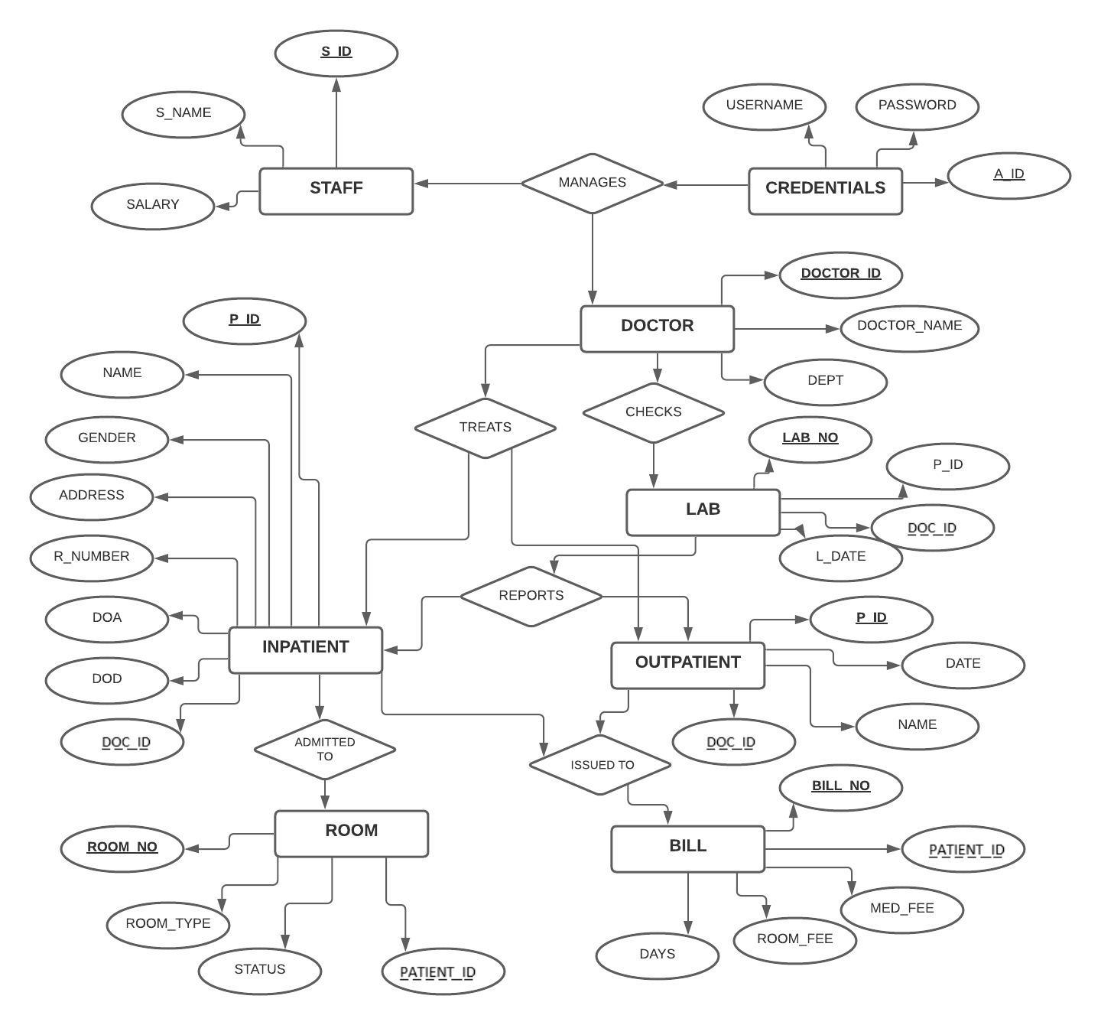
ER DIAGRAM:

Slide 13
DEMO ON USER INTEFACE

Slide 14
REFERENCES:
https://www.w3schools.com/php/php_mysql_connect.asp
https://www.w3schools.com/php/func_mysqli_query.asp
https://www.php.net/manual/en/mysqli.query.php
https://www.geeksforgeeks.org/how-to-insert-form-data-into-database-using-php/

Slide 15
THANK YOU!
BY
2019103523 | HARIPRIYA K
2019103526 | HEMAVARSHINI C
2019103553 | POOJASRI S

